Slide 1
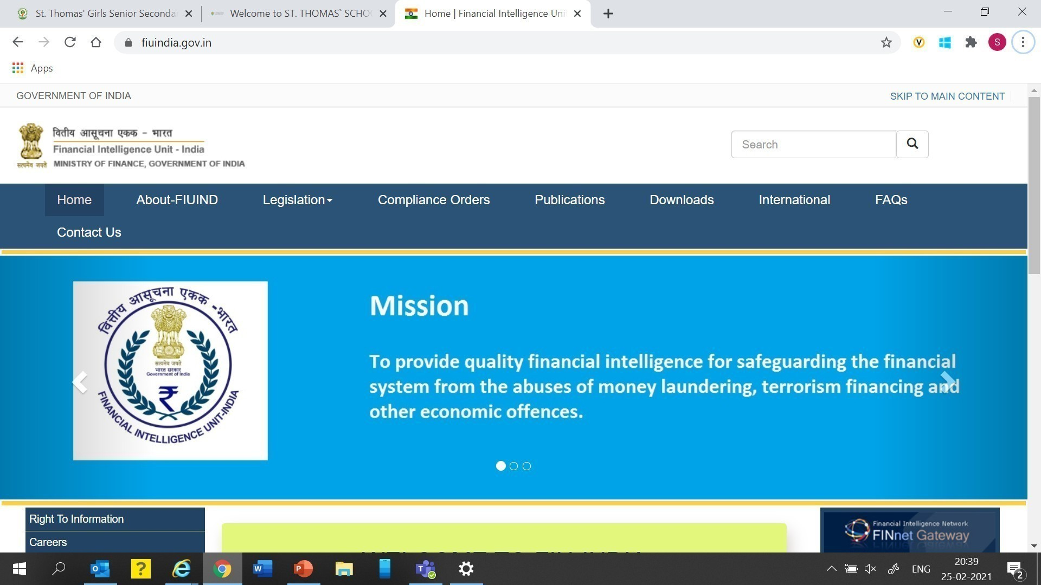
Financial Intelligence Unit – India Presentation to Director FIU FINnet 2.0 – Risk Scoring 27 May 2021

Slide 2

Agenda
Design Principles
Entity/ Individual Risk Scoring
Transaction Risk Scoring
Report Risk Scoring
GoS Risk
Network Risk
Case Risk

Slide 3
Agenda
Design Principles
Entity/ Individual Risk Scoring
Transaction Risk Scoring
Report Risk Scoring
GoS Risk
Network Risk
Case Risk

Slide 4
Risk Model design principles (1/5) – ‘Model construction’
Design | Description
Multi-model availability | The system will allow multiple models to be designed in FINNET 2.0. At any point in time, only one model will be made active, to maintain traceability. A designated user will own the models and may choose to change the active status as per FIU’s directions A history will be maintained in the system of the models used at various points in time
Multi-attribute risk data sheets | An entire library of model parameters will be maintained. These parameters will be derived from the reporting format, attributes enhanced from external agencies and those found from commercial risk databases The modeler would have the flexibility of the following: Ability to add or drop parameters from the parameter library into the active model Ability to select risk scoring metadata (if multiple exist). For instance: country risk may be chosen from the FATF list, or from Transparency International or from OECD Ability to adjust weights instead of using the pre-designed ones Save the revised model with a different model ID for future use

Slide 5
Risk Model design principles (2/5) – ‘Risk events’
Triggers for running each model (‘risk events’) are:
Type of risk model | Trigger / risk event
Individual / Organisation | Upon resolution of an individual / entity Upon being associated with any new case Periodic basis, depending upon risk assigned
Location | Location risk shall be run at the end of each month. It can also be updated by FIU as master data
Report | Upon receiving, after risk scoring of all entities within a report
Case | Upon case creation, after risk scoring of all reports within the case

Slide 6
Risk Model design principles (3/5) – ‘Risk history’
Risk history records the following in a timeline view: Version of the model to be run Complete audit trail of running a risk model covering: Model version, with parameters, weights, intervals, scores Value of each parameter for an entity being risk scored Value of the total risk and risk score assigned

Slide 7
Risk Model design principles (4/5) – ‘Outcomes’
Outcome | Description
Risk report | The analysts would also have the flexibility of generating their own reports or queries using parameters and filters The system will generate a risk report at the end of every month to be circulated to FIU officials The report would specifically highlight: Major changes to risk scores of entities and individuals High risk reports submitted in the past cycle High risk entities would be flagged / alerted
Ad-hoc case creation | The FIU analyst would be able to directly create a case from the risk screen itself A case can be created on a basis of a high risk report (STR) and the entities therein Case can also be created on the basis of high risk entities found as a result of the risk scoring – e.g. individuals found in high risk CTRs / CBWTRs (i.e. non STRs)

Slide 8
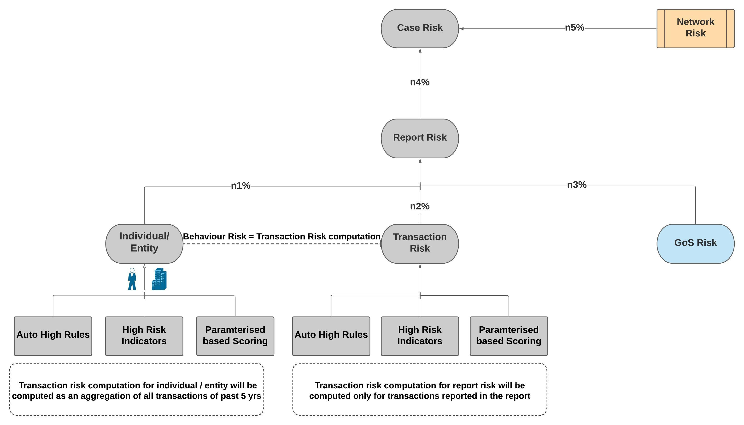
Risk Model design principles (5/5) – ‘Model Framework’

Slide 9
Agenda
Design Principles
Entity/ Individual Risk Scoring
Transaction Risk Scoring
Report Risk Scoring
GoS Risk
Network Risk
Case Risk

Slide 10
Entity Risk Scoring Model - (1/7)
Auto High Rules
Components | Examples
Auto High Rules Classified into binary scores of 0 and 1. An entity/individual will be automatically classified as High Risk if any of the Auto High Rule score is 1 | Entity/ its parent entity/ holding company/ related individuals exists on FIU or LEA watchlist Entity/ its parent entity/ holding company/ related individuals are flagged in the international sanction lists Multiple/invalid/wrong PAN number(s) identified Entity is struck off **Total 9 parameters in the model

Slide 11
Entity Risk Scoring Model - (2/6)
Auto High Rules
Components | Examples
Risk Indicators - KYC Classified into binary scores of 0 and 1 If 5 or more of the High Risk Indicators are 1, then entity will be categorised automatically as High Risk regardless of parameterised scores | Classified under High Risk business High number of bank accounts UBOs/IBOs/Directors/Partners/RCA are mentioned in the watch list Previous high risk or multiple medium/low risk reports filed Adverse Media Screening reveals high risk tags on account holder **Total 29 parameters in the model
Risk Indicators - KYC

Slide 12
Entity Risk Scoring Model - (3/6)
Auto High Rules
Components | Examples
Risk Indicators - TX Classified into binary scores of 0 and 1 If 5 or more of the High Risk Indicators are 1, then entity will be categorised automatically as High Risk regardless of parameterised scores | Cross border transactions originates from/destined to high risk country(ies) Transactions originated from/destined to high risk entities/individuals Transactions inward from multiple senders or outward to multiple beneficiaries in a short period of time High Value Property transaction in High risk domestic location beyond a certain threshold **Total 38 parameters in the model * Additionally, each report submitted would have their own risk indicators that would be rolled up to the entities
Risk Indicators – KYC
Risk Indicators – TX

Slide 13
Entity Risk Scoring Model-(5/6)
Auto High Rules
Components | Examples
Parameter based risk scoring - Inherent Inherent Risk is due to the profile / location / nature of business etc of the entities Each parameter will have an associated risk scoring sheet All risk scores will range from 1 to 10 with 10 being the highest risk | Entity type and its parent's entity type (if exists) Type of accounts held Type of Business/HSN code UBO and IBO risk (as found) Number of Reports Filed and Risk of Reports Date of last KYC / re-KYC Corporation Age Risk / DOI **Total 16 parameters in the model
Risk Indicators – KYC
Risk Indicators – TX
Risk Indicators – Annual Behaviour
Parameter / Weight based scoring for
‘Inherent Risk’

Slide 14
Entity Risk Scoring Model-(5/6)
Auto High Rules
Components | Examples
Parameter based risk scoring - Transaction This is computed on the basis of reported history. It is based on volume, frequency, location, value and type of transactions Each parameter will have an associated risk scoring sheet All risk scores will range from 1 to 10 with 10 being highest risk | Type of Transaction Cash at Branch_Location Risk Cash at Branch_Value Risk Cash at Branch_Volume Risk Cash at Branch_Frequency of transactions Risk CBWT_Location Risk CBWT_Value Risk CBWT_Volume Risk CBWT_Frequency of transactions Risk **Total 25 parameters in the model
Risk Indicators – KYC
Risk Indicators – TX
Risk Indicators – Annual Behaviour
Parameter / Weight based scoring for
‘Inherent Risk’
Parameter / Weight based scoring for
‘Transaction Risk’

Slide 15
Entity Risk Scoring Model - Aggregation - (6/6)
Auto High Rules
Risk Model
Entity Risk This is computed on the basis of all the individual components This will be run every time an entity is reported in any report All risk scores will range from 1 to 10 with 10 being the highest risk
Risk Indicators – KYC
Risk Indicators – TX
Risk Indicators – Annual Behaviour
Entity Risk
Parameter / Weight based scoring for
‘Inherent Risk’
Parameter / Weight based scoring for
‘Transaction Risk’

Slide 16
Agenda
Design Principles
Entity/ Individual Risk Scoring
Transaction Risk Scoring
Report Risk Scoring
GoS Risk
Network Risk
Case Risk

Slide 17
Transaction risk of the Entity/Report
Transaction risk comprises of following parameters-
1
Inherent Risk is based on type of transaction (e.g. CBWT is riskier than UPI)
Behaviour Risk is the computation formula based on-
Volume/number of transaction
Value/amount of transaction
Location of transaction
Ageing of transaction
Frequency/velocity of transaction (Inverse of time period)
For each of the parameters (stated above), individual/computation datasheets will be prepared
The overall computation formula will also be provided as part of the design
2
3
4

Slide 18
Examples of Transaction Risk Computation (1/7)
Case: Cash Transaction Report (CTR) was filed by XYZ Bank on Mr. Grey who is a Salaried Individual
Mr. Grey is a school teacher earns Rs 40,000 per month and has saving account in XYZ bank in Srinagar.
On 1 March, he made three cash deposits of Rs. 1,00,000 each into his account in XYZ Bank (Srinagar).
On 8 March, 2 cash deposits of Rs 1,00,000 were made into his account through Amritsar based Branch of XYZ bank.
On 15 March, another 2 cash deposits of Rs. 150,000 each made into his account through Jammu based Branch of XYZ bank.
On 20 March, he again visited XYZ Bank (Srinagar) and made four cash deposits of Rs. 75,000 each into his account.

Slide 19
Transaction Risk Computation (2/7)
STEP 1 : Value/Amount of Transaction Risk
In March, Mr. Grey has made total cash deposits of Rs 11 lakh into his account. Using below Cash at branch value scale table, Rs 11 lakh falls under the scale of 10. Hence, value risk score of Mr. Grey comes out to be 10 which is the high risk score.
Cash at Branch Value risk (Indicative)
Score Entity Type | 1 | 2 | 3 | 4 | 5 | 6 | 7 | 8 | 9 | 10
Individual - salaried | 0-40,000 | 40,000-60,000 | 60,000-80,000 | 80,000-1,00,000 | 1,00,000-2,00,000 | 2,00,000-4,00,000 | 4,00,000-6,00,000 | 6,00,000-8,00,000 | 8,00,000-10,00,000 | 10,00,000+
Individual - business | 0-40,000 | 40,000-90,000 | 90,000-1,40,000 | 1,40,000-2,40,000 | 2,40,000-4,00,000 | 4,00,000-6,50,000 | 6,50,000-9,00,000 | 10,00,000-14,00,000 | 14,00,000-20,00,000 | 20,00,000+
LLP | 0-1,00,000 | 1,00,000-2,00,000 | 2,00,000-3,00,000 | 3,00,000-5,00,000 | 5,00,000-7,00,000 | 7,00,000-9,00,000 | 9,00,000-12,00,000 | 12,00,000-15,00,000 | 15,00,000-50,00,000 | 50,00,000+
LLC | 0-50,000 | 50,000-1,00,000 | 1,00,000-1,50,000 | 1,50,000-2,50,000 | 2,50,000-3,00,000 | 3,00,000-6,00,000 | 6,00,000-12,00,000 | 12,00,000-20,50,000 | 20,50,000-35,00,000 | 35,00,000+
Partnership Firms | 0-20,000 | 20,000-40,000 | 40,000-90,000 | 90,000-1,50,000 | 1,50,000-3,00,000 | 3,00,000-6,00,000 | 6,00,000-10,00,000 | 10,00,000-14,00,000 | 14,00,000-25,00,000 | 25,00,000+

Slide 20
Transaction Risk Computation (3/7)
STEP 2 : Volume/number of Transaction Risk
Mr. Grey has done 11 debit transactions in March. Using below volume scale table, 11 transactions fall under the scale of 7. So, volume risk score of Mr. Grey stands at 7
Cash at Branch Volume risk (Indicative)
Score Entity Type | 1 | 2 | 3 | 4 | 5 | 6 | 7 | 8 | 9 | 10
Individual - salaried | 0--1 | 1--2 | 2--3 | 3--4 | 4--8 | 8--10 | 10--12 | 12--15 | 15--20 | 20+
Individual - business | 0--3 | 3--5 | 5--8 | 8--12 | 12--15 | 15--20 | 20--25 | 25--30 | 30--35 | 35+
LLP | 0--2 | 2--4 | 4--6 | 6--8 | 8--10 | 10--15 | 15--20 | 20--30 | 30--40 | 40+
LLC | 0--4 | 4--8 | 8--12 | 12--16 | 16--20 | 20--24 | 24--28 | 28--35 | 35--45 | 45+
Partnership Firms | 0--3 | 3--5 | 5--7 | 7--11 | 11--14 | 14--19 | 19--24 | 24--25 | 25--30 | 30+

Slide 21
Transaction Risk Computation (4/7)
STEP 3 : Location Risk
Mr. Grey have made all transfers through 4 different branches’ locations which are Srinagar, Amritsar, Jammu and Delhi. Each of 4 locations score is identified through below domestic location risk table. Average of the 4 identified scores is the Location risk score of Mr. Grey which comes around 9.5. If the transaction were international, country risk score would be used.
Domestic location (Indicative) | Risk Score (Indicative) |  | Countries (Indicative) | Risk Score (Indicative)
Ahmedabad | 7 |  | Afghanistan | 10
Amritsar | 9 |  | Austria | 4
Bilaspur | 3 |  | Clipperton Island | 4
Chandigarh | 6 |  | Chile | 4
Chennai | 8 |  | Croatia | 4
Coimbatore | 3 |  | Dominican | 8
Delhi | 10 |  | Ecuador | 8
Ghaziabad | 4 |  | France | 4
Lakshadweep | 5 |  | Germany | 4
Jammu | 9 |  | Guinea-Bissau | 8
Patna | 8 |  | Saint Barthelemy | 4
Pune | 8 |  | Saint Martin | 4
Srinagar | 10 |  | Ukraine | 9

Slide 22
Transaction Risk Computation (5/7)
STEP 4 : Frequency/velocity of transaction
Since overall time period of execution of transactions is 20 days which is a short time period, hence, this parameter’s risk score is 10
Note: Frequency/velocity of transactions is negatively correlated with AML risk
Risk score
10
Risk score
9
Risk score
8
Risk score
7
Risk score
6
Risk score
5
Risk score
4
Risk score
3
Risk score
2
Risk score
1
1 month
2 months
3 months
4 months
5 months
6 months
7 months
8 months
9 months
10 months
For example, 20 lakh of transaction executed in 1 month carries higher risk in comparison to same amount of transaction
done in 6 months time frame

Slide 23
Transaction Risk Computation (6/7)
STEP 5 : Type of Transaction Risk
Type of Transaction risk is the inherent risk of Transaction type which is risk scored from 1 to 10 (shown below). According to which, Salaried Individual’s risk score of “Cash at branch” transaction type stands at 7
Type of Transactions | Risk category (Indicative)
Cash at Branch | 7
Cash at ATM | 7
NEFT | 4
RTGS | 4
UPI | 2
IMPS | 2
CBWT | 9
CCT | 9
Property Transactions | 7
NGO/NPO Transactions | 7

Slide 24
Transaction Risk Computation (7/7)
STEP 6 : Transaction risk
Transaction Risk Score = (7+ 10 + 7+ 9.5 + 10)/5=8.7
(Note: All 5 parameters’ risk scores for individual are determined in aforementioned 5 steps)
Tranx Risk= Tranx Type Risk + Vol Risk + Value Risk + Location Risk + Freq Risk
5
Salaried customer_CTR (Cash at Branch)
Date | Mode | Tranx Value | Tranx Vol | Location | Location Risk Score
 |  | Dr. (in Rs.)
01-03-2021 | Cash | ₹ 3,00,000.00 | 3 | Srinagar | 10
08-03-2021 | Cash | ₹ 2,00,000.00 | 2 | Amritsar | 9
15-03-2021 | Cash | ₹ 3,00,000.00 | 2 | Jammu | 9
20-03-2021 | Cash | ₹ 3,00,000.00 | 4 | Delhi | 10
Monthly summation |  | ₹ 11,00,000.00 | 11 |  | 38
Risk Score |  | 10 | 7 |  | 9.5
Peer Group | Tranx Type Risk | Value Risk | Vol Risk | Location Risk | Freq of Tranx | Tranx Risk
Salaried | 7 | 10 | 7 | 9.5 | 10 | 8.7

Slide 25
Agenda
Design Principles
Entity/ Individual Risk Scoring
Transaction Risk Scoring
Report Risk Scoring
GoS Risk
Network Risk
Case Risk

Slide 26
Report Risk Scoring Model – (1/6)
Auto High Rules
Components | Examples
Auto High Rules Classified into binary scores of 0 and 1. A report will be automatically classified as High Risk if any of the Auto High Rule score is 1 | Any of involved parties in the report exists on FIU or LEA watchlist LEA adhoc request previously raised on any of involved parties Any party/institution involved in the transactions are flagged in the international sanction lists Adverse Media Screening reveals auto high risk tags on any of involved parties in the report (TF/ML) **Total 4-7 parameters in the model (few variations report wise)

Slide 27
Report Risk Scoring Model – (2/6)
Auto High Rules
Components | Examples
Risk Indicators - CBWTR Classified into binary scores of 0 and 1 If 5 or more of the High Risk Indicators are 1, then entity will be categorised automatically as High Risk regardless of parameterised scores | High-risk Purpose Code reported in CBWTR Transactions involve high risk currencies Transactions involve high risk country(ies) Previous high risk or multiple medium/low risk reports filed No. of accounts greater than a threshold High value transactions originated from or destined to high risk entities/individuals above certain threshold Institution(s) in the CBWTR chain belongs to high-risk country(ies) **Total 28 parameters in the model
Risk Indicators - CBWTR

Slide 28
Report Risk Scoring Model-3/6
Auto High Rules
Components | Examples
Risk Indicators - CTR Classified into binary scores of 0 and 1 If 5 or more of the High-Risk Indicators are 1, then entity will be categorised automatically as High Risk regardless of parameterised scores | Transactions conducted in short span of time at different bank branches Cash deposits/withdrawals via ATMs in high-risk locations Multiple cash deposits/withdrawals in short period of time Previous high risk or multiple medium/low risk reports filed High value transactions reported above certain threshold Adverse Media Screening reveals high risk tags on any of involved parties in the transaction **Total 15 parameters in the model
Risk Indicators - CTR

Slide 29
Report Risk Scoring Model-4/6
Auto High Rules
Components | Examples
Risk Indicators - STR Classified into binary scores of 0 and 1 If 5 or more of the High-Risk Indicators are 1, then entity will be categorised automatically as High Risk regardless of parameterised scores | GoS tags reveals high risk tags on any of entities in the report Source/Destination of Fund is reported by RE as "Unknown“ Total amount of credits/debits greater than x% of annual income (ITR) Previous high risk or multiple medium/low risk reports filed Multiple transactions originates from/destined to single account in short period of time **Total 27 parameters in the model
Risk Indicators - STR

Slide 30
Report Risk Scoring Model-4/6
Auto High Rules
Components | Examples
Risk Indicators - NTR Classified into binary scores of 0 and 1 If 5 or more of the High Risk Indicators are 1, then entity will be categorised automatically as High Risk regardless of parameterised scores | Cancellation of FCRA Registration Black listed NGO Donation from single entity greater than particular threshold Multiple donors contributing more than particular threshold Large volumes of cash deposit in short period of time Existence of FCRA a/c with NPO Deposits above certain threshold **Total 21 parameters in the model
Risk Indicators - NTR

Slide 31
Report Risk Scoring Model-6/6
Auto High Rules
Risk Model
Report Risk Extract all entities (both individual and legal entities) and score them individually Extract all transactions and score as per Transaction risk Extract GoS* (in case of STR) Aggregate above scores into Report Risk *explained in next section
Risk Indicators – CBWTR
Risk Indicators – CTR
Risk Indicators –STR
Risk Indicators –NTR
Report Risk
Parameter / Weight based scoring for all transactions
GoS Risk (STR only)
Aggregate for all entities/individual in the reports as per entities/individual risk model

Slide 32
Report Risk Aggregation
Report risk:
Note: Earlier stated 6 steps will get repeated for computing risk score of each Transaction. Secondly, each entity/individual will be scored as per Entity/ Individual Risk Model. Followed by aggregation of all scores including GoS risk score (ifapplicable) into Report risk.
Mr Grey _Report Risk = (8.7+ 9)/2=8.85
Inherent risk is the static risk of Individual, whose calculation methodology already covered in previous part of presentation. However for calculation purposes in current example, score of Inherent Risk of Mr. Grey is the assumed to be 9 (based on his given attributes)
Calculation of Transaction Risk of Mr. Grey is featured in aforementioned step 6
Based on above stated calculation, overall report risk of Mr. Grey is 8.85
Report risk = Average[Transaction Risk , Inherent Risk of Entity or Individual Risk, GoS Risk (in case of STR)]
(
)
Report Risk (Salaried)
8.85
=
Transaction Risk (Salaried)
8.7
:
Inherent Risk (Salaried)
9
AVERAGE

Slide 33
Agenda
Design Principles
Entity/ Individual Risk Scoring
Transaction Risk Scoring
Report Risk Scoring
GoS Risk
Network Risk
Case Risk

Slide 34
GoS Risk Approach
GoS
Risk
∑
∑
Annual (GoS) Risk
Tag
Risk
List Based Risk Approach (1 to 10)
Peer Grouping based Risk Approach
Suspicion Due To
Source of Alert
Red Flag Indicator
Type of Offence Suspected
Total debit, credit and cash in last 12 months
Source and destination of funds

Slide 35
GoS risk – Tags based Scoring
Tag based score
Objective | Description
GoS Tag 1 - Suspicion Due To | Proceeds of Crime Unusual or Complex Transactions No Economic Rationale or Bonafide purposes Suspicion of Financing of Terrorism
GoS Tag 2 - Source of Alert | From where alert got generated (Origination of Alert )- Transaction Monitoring/Branch Monitoring etc.
GoS Tag 3 - Red Flag Indicator | Algorithm based configuration of RFI indicators/rules violation such as Structuring/geography based rule/ large/rapid movement of fund/profile deviation etc.
GoS Tag 4 - Type of Offence Suspected | Underlying Predicate offenses- Hawala/Tax Evasion/Bribery/Fraud/ identical invoicing/ association with sanction countries/ shell company links etc.
This is computed on basis of reported history
Each parameter will have an associated risk scoring sheet
All risk scores will range from 1 to 10 with 10 being highest risk
Computation formula will be applied to calculate the composite score based on all the tags reported

Slide 36
GoS risk – Annual Behaviour based Risk
Tag based score
Components | Examples
Risk Indicators - Annual Behaviour based Risk Indicators Classified into binary scores of 0 and 1 If 5 or more of the High Risk Indicators are 1, then entity will be categorised automatically as High Risk regardless of parameterised scores | Total amount of credit greater than x% of reported annual income Total amount of debit greater than x% of reported annual income Immovable Property value greater than x% of reported annual income Credit card transactions greater than x% of reported annual income Mutual investments greater than x% of reported annual income **Total 9 parameters in the model
Risk Indicators – Annual Behaviour
Source and Destination

Slide 37
Agenda
Design Principles
Entity/ Individual Risk Scoring
Transaction Risk Scoring
Report Risk Scoring
GoS Risk
Network Risk
Case Risk

Slide 38
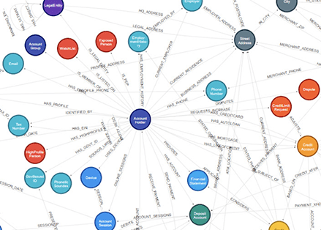
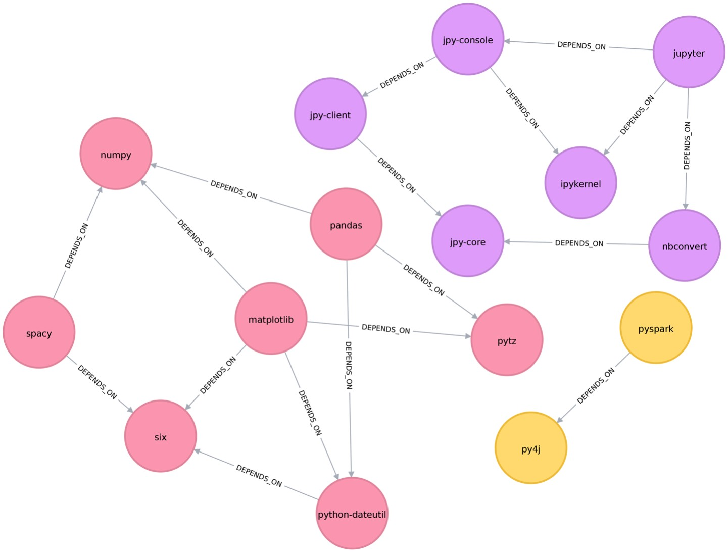
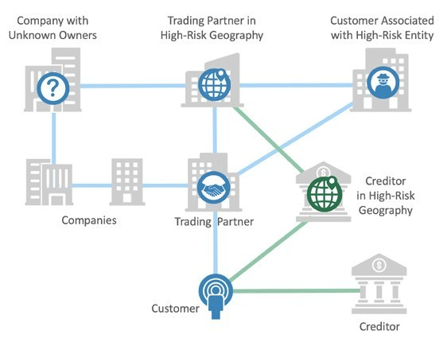
Network risk assessment steps
Step 1
Creating the Graph DB basis entity and relationship information
(this is a backend process by the system)
Step 2
Identification of network of FIU’s ‘entities of interest’
Step 3
Computation of network risk for ‘entities of interest’

Slide 39
Step 1 – Creating the Graph DB
System shall create a network with entities as nodes and relationships as arcs
Entities are person, organisation, account, location, branch, ATM
Entities shall also have attributes and tags - such as STR, CTR (filed), high risk, watchlist etc
Relationships have been identified as type of relationship (permanent, transaction based) and scored basis confidence and strength in relationship resolution

Slide 40
Step 1 – Creating the Graph DB

Slide 41
Step 2 – Identification of network of FIU’s ‘entities of interest’
For all the nodes (entities) identified in a case, the system shall identify the network of set of connected nodes
This will help identify the section of overall network to be evaluated by the Case Analyst to evaluate only a few ‘islands’ within the overall FIU network
Within the ‘island’, the Case Analyst can analyse each entity and their connectedness to other entities
Case Analyst can:
Navigate the entire network of entities
Filter to see only a certain type of entities
Add more remove tags, relationships in the network and/or database

Slide 42
Step 2 – Identification of network of FIU’s ‘entities of interest’
Entity B
Entity C
Entity X
Entity F
Entity G
Entity D
Entity Y
Entity A
Entity H
Entity J
Entity E
Entity Z
Entity of Interest 2
Entity of Interest 1
Island 1
Island 2

Slide 43
Step 3 – Computation of network risk
Network risk is computed for each node within a case, due to its association with other high / medium risk rated network nodes. This is known as risk by association
Risk by Association score shall be based on the entity’s relationship with other high / medium risk entities on the basis of
Quantity of relations
Strength and confidence of relation
Distance of relation (number of hops between nodes)

Slide 44
Step 3 – Computation of network risk

Slide 45
Agenda
Design Principles
Entity/ Individual Risk Scoring
Transaction Risk Scoring
Report Risk Scoring
GoS Risk
Network Risk
Case Risk

Slide 46
Case Risk Aggregation
Case specific Risk Indicators
Risk Model
Case Risk Extract all reports and score as per Report Risk Extract network of entities/ individuals and score network risk Extract all entities/ individual and score them individually Aggregate above scores into Case Risk
Aggregate for all reports in the case as per report risk model
Case Risk
Aggregate for all entities/individual in the reports as per entities risk model
Network Risk

Slide 47
THANK YOU

